Slide 1
RESORT MANAGEMENT SYSTEM
INFO6210: Data Management and Database Design
Team 18
Ria Agnes Jose
Rishi Jatania
Vidya Ravi Mohana Reddy
Meghana Kandru

Slide 2
MISSION STATEMENT & OBJECTIVES
To organize and maintain data relevant to business operations and management aspects of a Resort chain.
This design will enable the enterprise to define new strategies and to review the revenue impact on the business.
Allows the Resorts administrative, marketing and sales team to generate descriptive reports related to sales and revenue of the resort.
Provides information on the sales and revenue of the rooms and activities based on customer booking pattern.

Slide 3
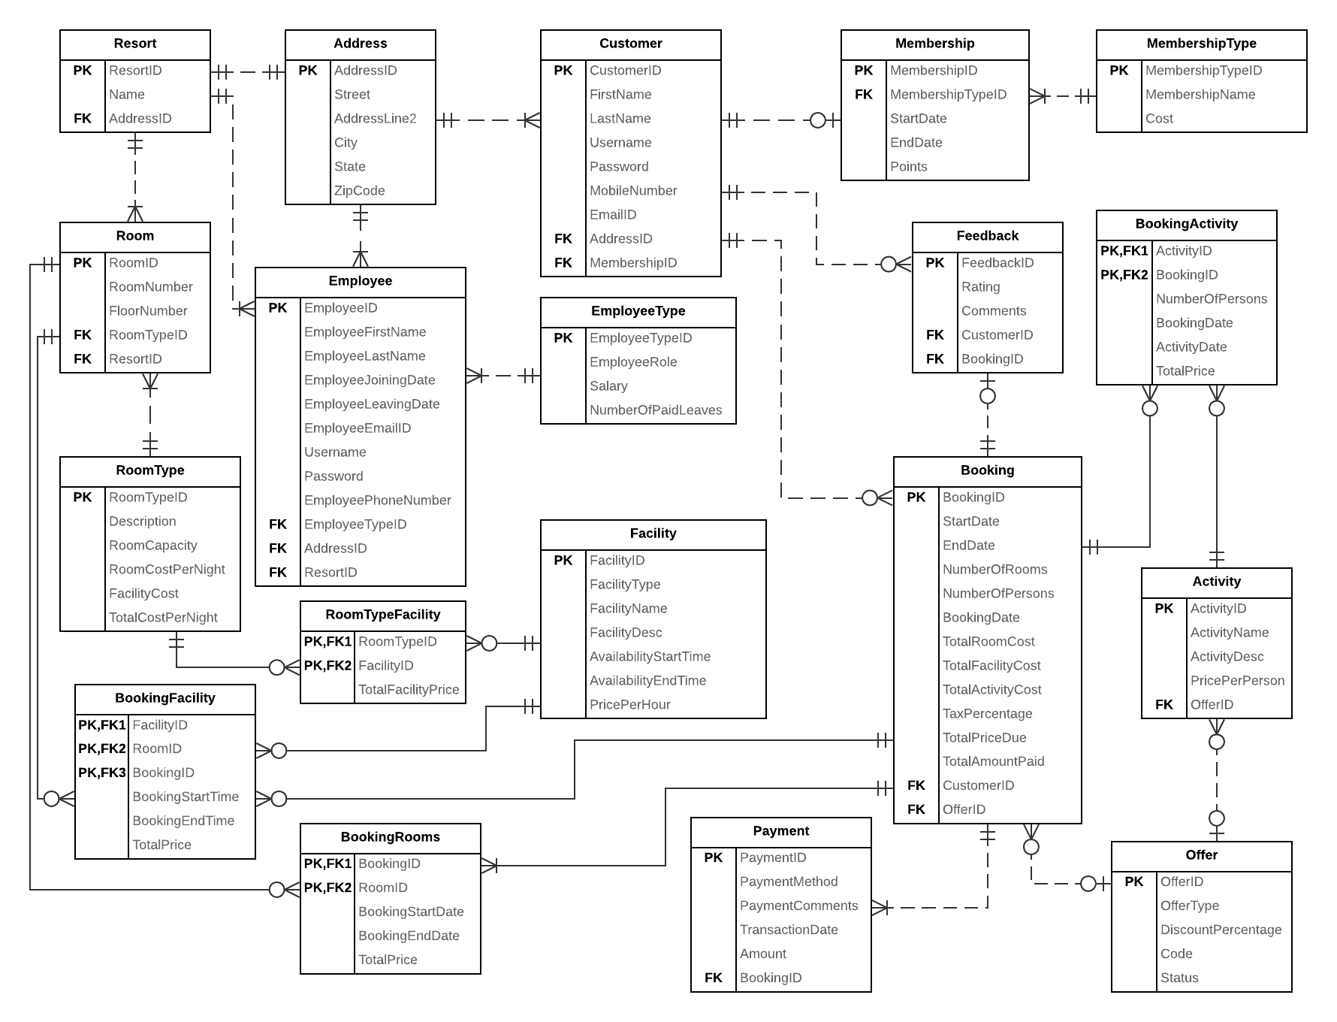
ERD

Slide 4
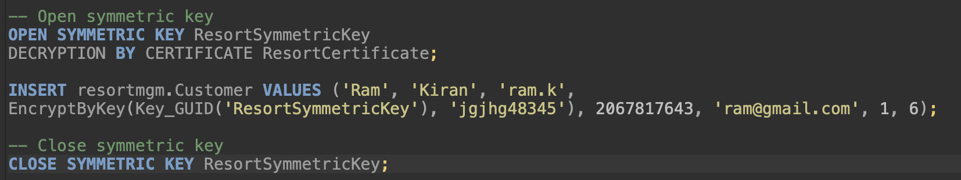
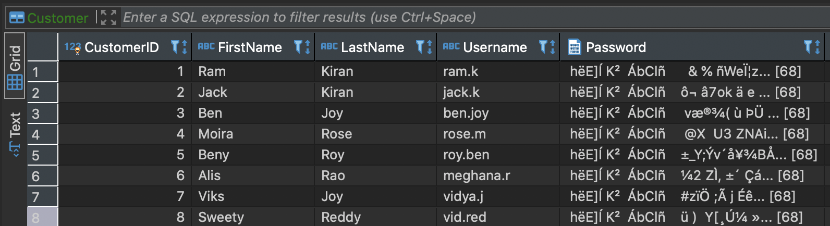
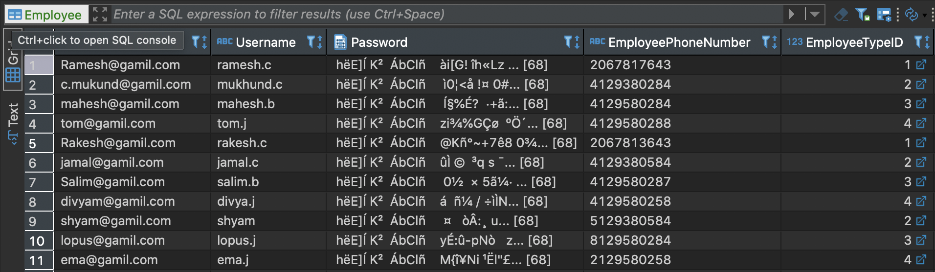
DATABASE IMPLEMENTATION (DDL)
Column Data Encryption
-- Create DMK
CREATE MASTER KEY ENCRYPTION BY PASSWORD = 'Team18_P@sswOrd';
-- Create certificate to protect symmetric key
CREATE CERTIFICATE ResortCertificate
WITH SUBJECT = 'Resort Management Certificate', EXPIRY_DATE = '2030-10-31';
-- Create symmetric key to encrypt data
CREATE SYMMETRIC KEY ResortSymmetricKey
WITH ALGORITHM = AES_256
ENCRYPTION BY CERTIFICATE ResortCertificate;
Customer Table
Employee Table

Slide 5
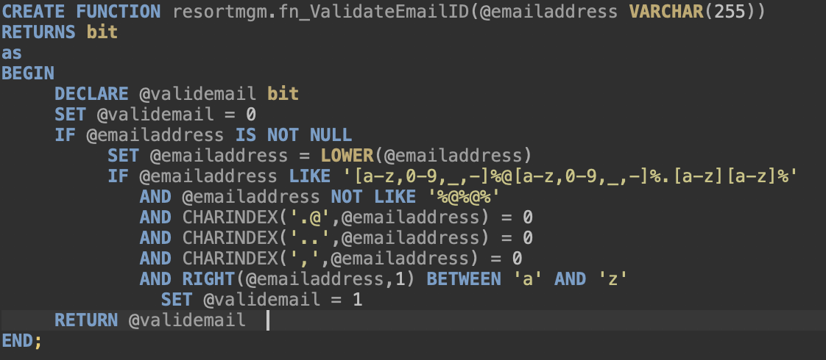
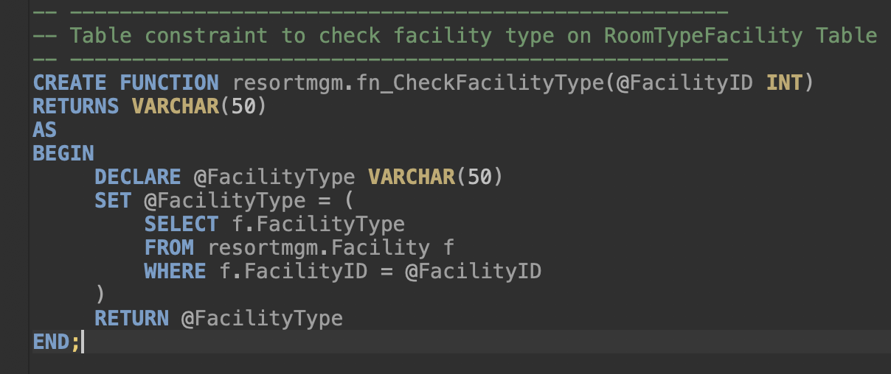
DATABASE IMPLEMENTATION(DDL)
Table-Level Check Constraints
Function to validate the Email address of Employee and Customer.
To check the Employee and Customer Phone Numbers
CONSTRAINT EmployeePhone CHECK (EmployeePhoneNumber NOT LIKE '%[^0-9]%')
To check the start date and end date in employee, booking, facility and activity table.
CONSTRAINT EmployeeLeavingDate CHECK(EmployeeJoiningDate < EmployeeLeavingDate)
Function To allow only Facility Type Room for Entity RoomTypeFacility

Slide 6
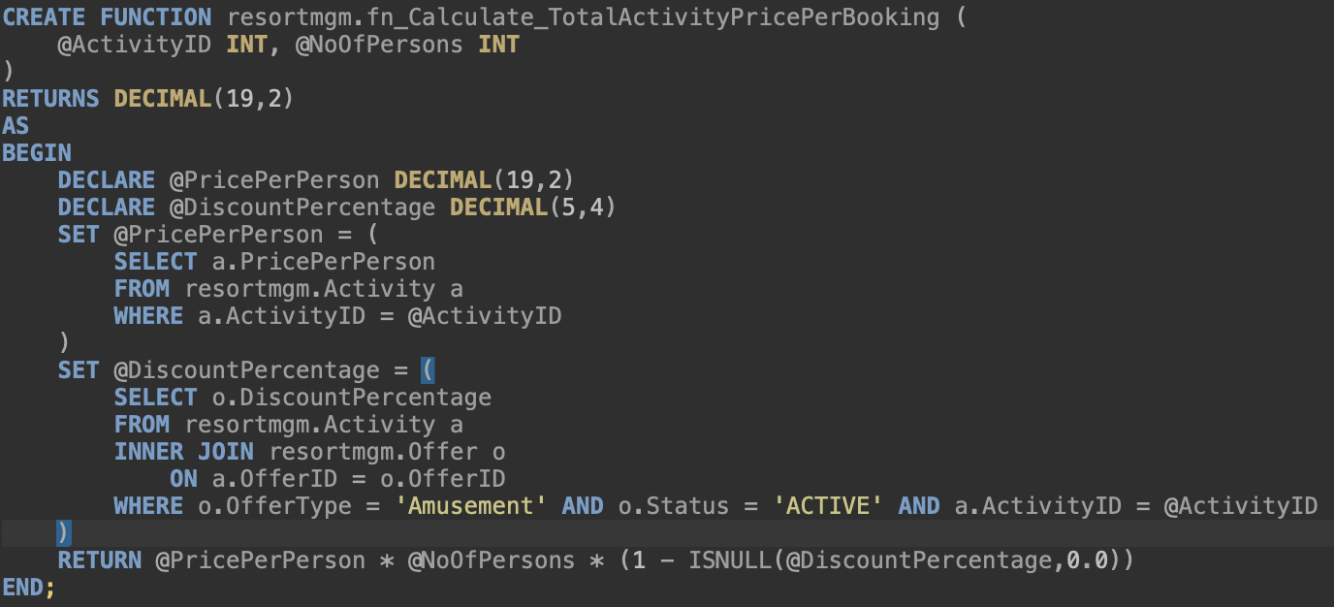
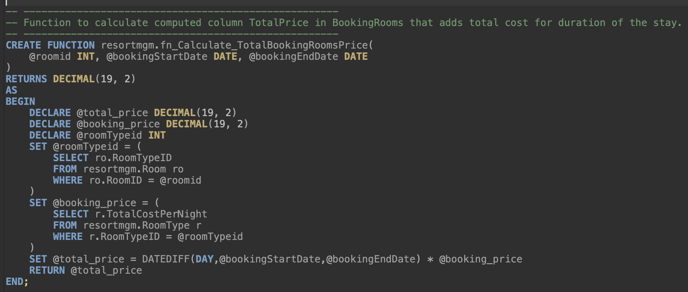
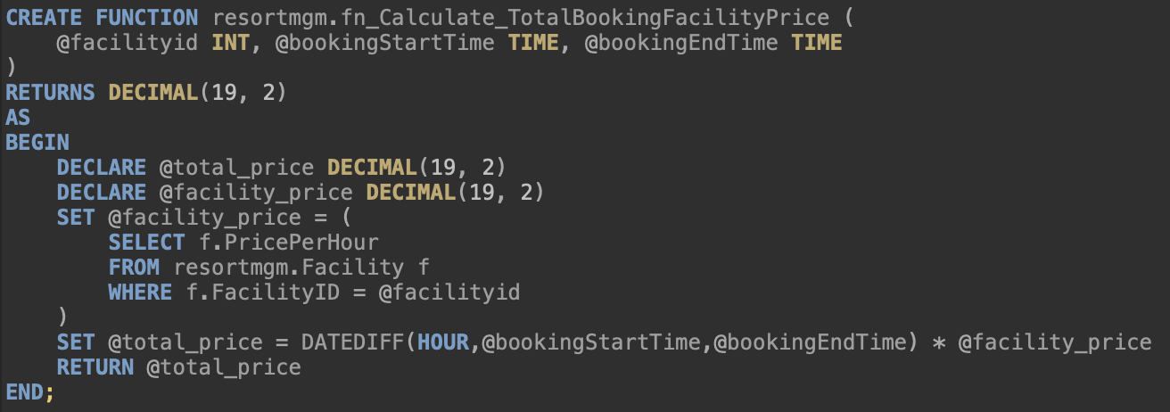
DATABASE IMPLEMENTATION (DDL)
Column Computation based on a function
To Calculate Total Activity Cost per booking for a customer in Bookings Table
To calculate Total Room Cost of per Booking for every rooms booked by the customer based on the duration of the stay
To calculate computed column Total Facility Price in entity BookingFacility based on the facility price per hour

Slide 7
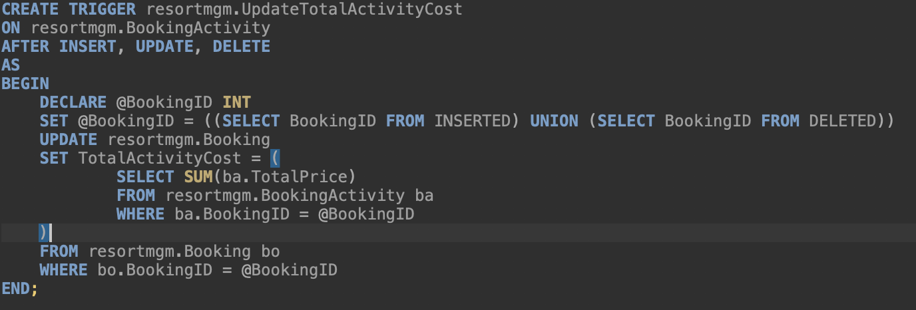
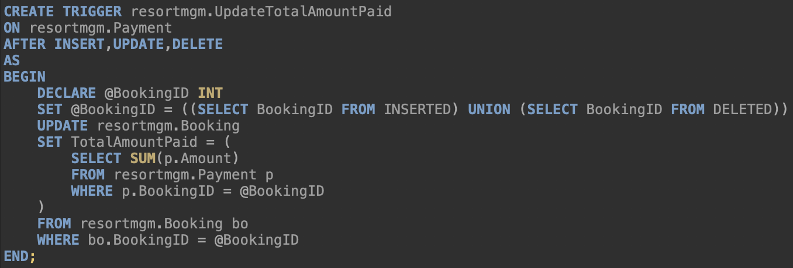
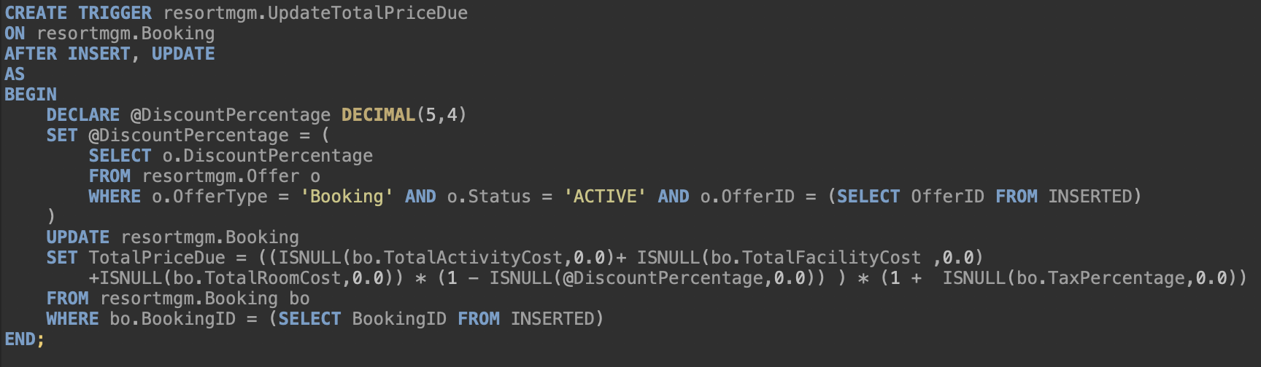
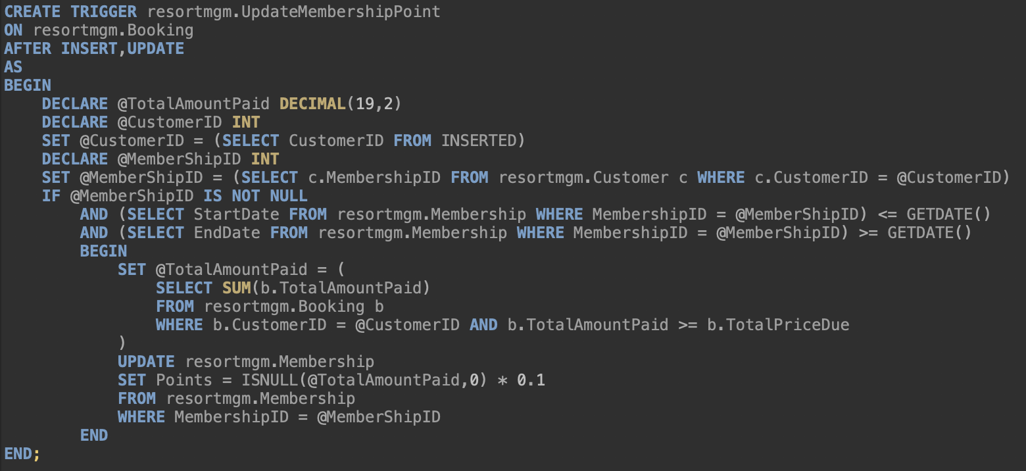
TRIGGERS
Calculate TotalActivityCost in Booking table from total price in BookingActivity table
TotalActivityCost = SUM (TotalPrice) for a BookingID
Update TotalAmountPaid in Booking table when Amount is updated in Payment table
TotalAmountPaid = SUM (Amount) for a BookingID
Calculate TotalPriceDue in Booking on insert in
Booking table
TotalPricedue = SUM(TotalActivityCost, TotalFacilityCost, TotalRoomCost, Discount, Tax) for a BookingID
UpdateMembershipPoints Trigger
​Membership Points = TotalAmountPaid * 0.1

Slide 8
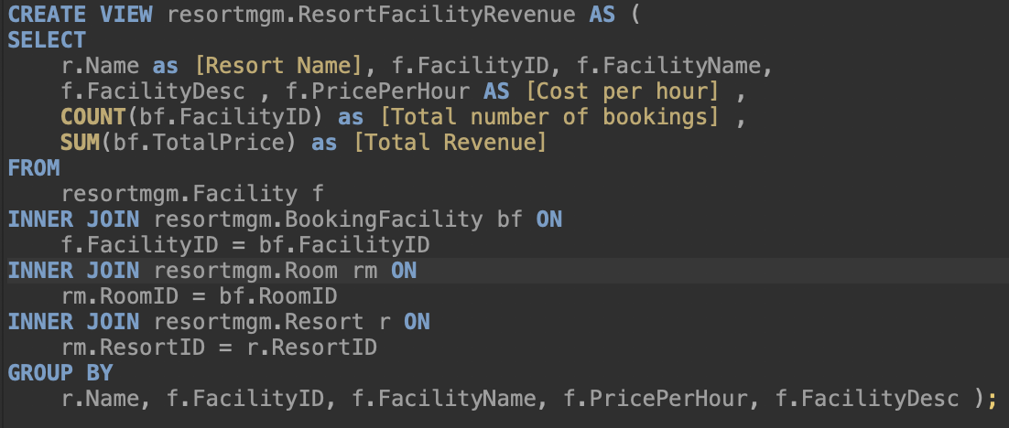
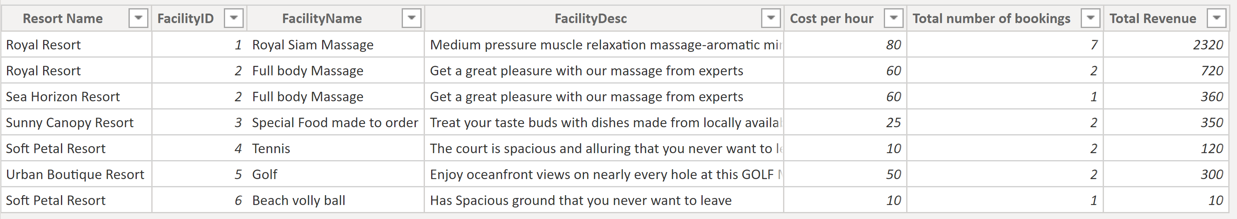
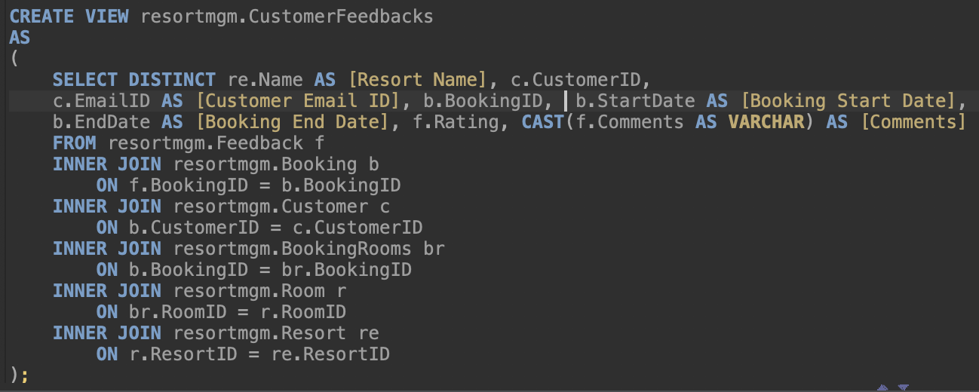
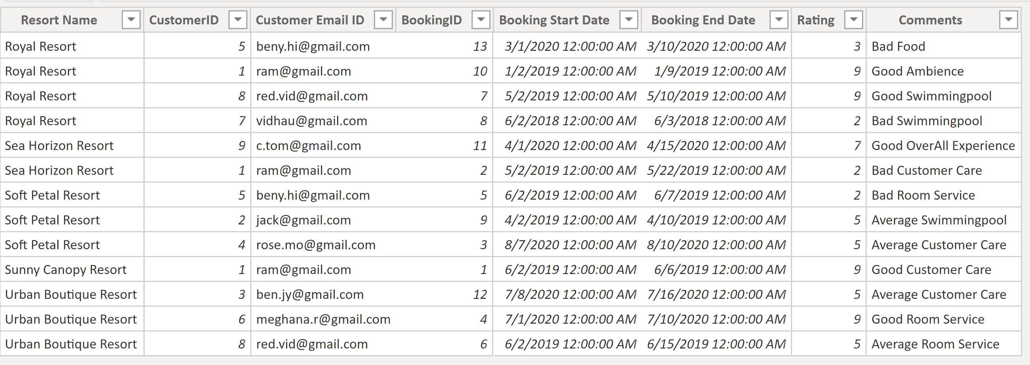
VIEWS
To track resort's revenue from facilities
To analyze resort reviews based on customer feedbacks

Slide 9
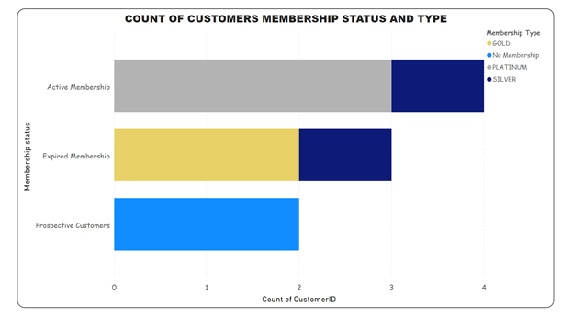
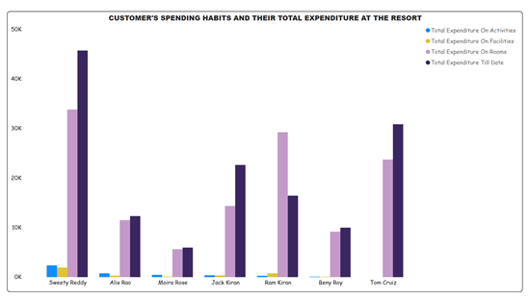
VISUALIZATIONS

Slide 10
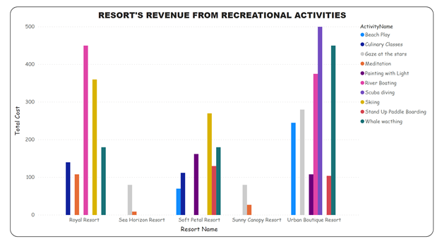
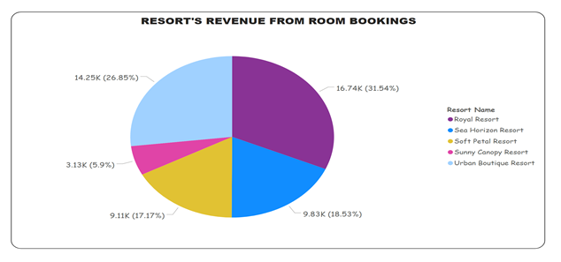
VISUALIZATIONS

Slide 11



